Slide 1
Project
on
“ Phishing attack Detection using
Machine Learning ”
Submitted by:
Rohit Singh Rawat
3rd Sem
B Tech (CSE)
2021395
Submitted to:
Dr. Mohammad Wazid
Professor

Slide 2

Table of Contents
1
Introduction
2
Methodology
3
Data Collection
4
Feature Extraction
5
Model Development
6
Results and Evaluation
7
Conclusion and Future work

Slide 3

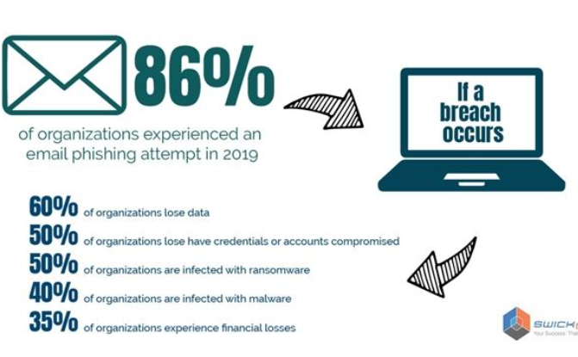
Introduction
Phishing is a type of cyberattack in which attackers attempt to deceive individuals into providing sensitive information such as passwords, credit card numbers, or other personal details.
The goal of this mini-project is to develop a model capable of accurately identifying phishing websites.

Slide 4

Problem Statement
Growing Threat
User Vulnerability
Phishing attacks pose a growing threat to individuals and organizations, leading to financial losses and compromised sensitive information.
Users often fall victim to phishing scams due to lack of awareness and susceptibility to social engineering tactics.
Detection Challenges
Traditional security measures struggle to accurately detect and prevent increasingly sophisticated phishing attacks.

Slide 5

5 TYPES OF PHISHING
Email phishing
Spear phishing
Attackers send deceptive emails impersonating trusted entities
Targeted phishing where customized messages are crafted
Clone phishing
Whaling
Attacker creates a nearly identical or "cloned" version of a legitimate website.
Specifically targets high-profile individuals.
Pop-up phishing
Cybercriminals use pop-up windows or dialogs are used.

Slide 6
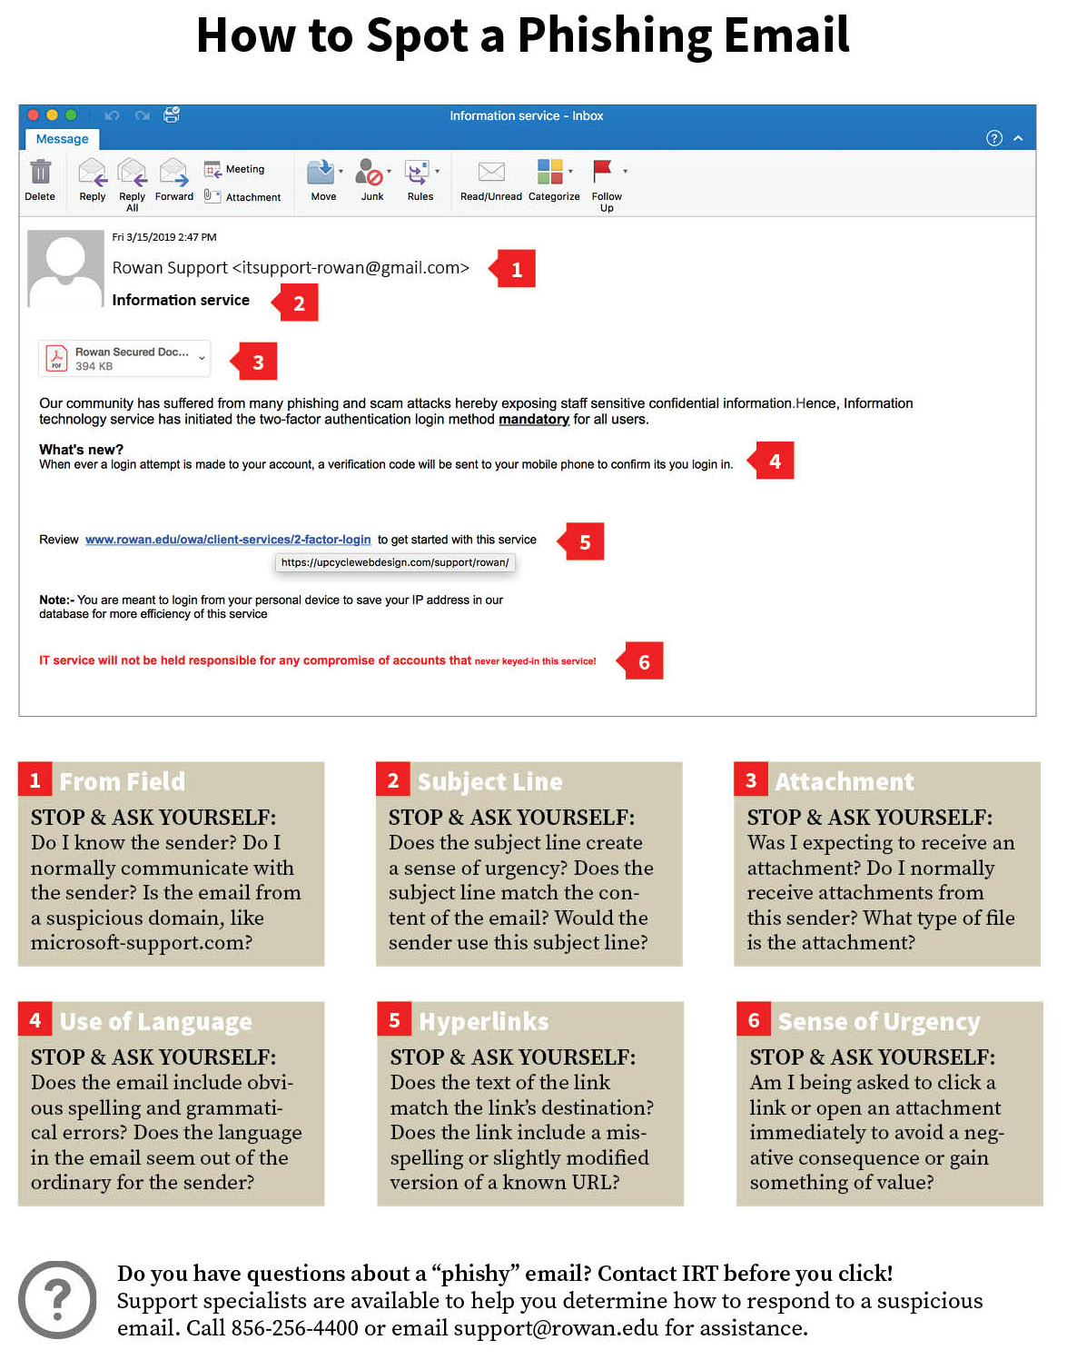

Slide 7
Methodology
1
Data Collection
Gather relevant datasets and information related to known phishing attacks and patterns.
2
Feature Extraction
Identify and extract key features from the collected data to build a robust detection model.
3
Model Development
Utilize machine learning and AI techniques to develop an effective and efficient phishing attack detection model.

Slide 8


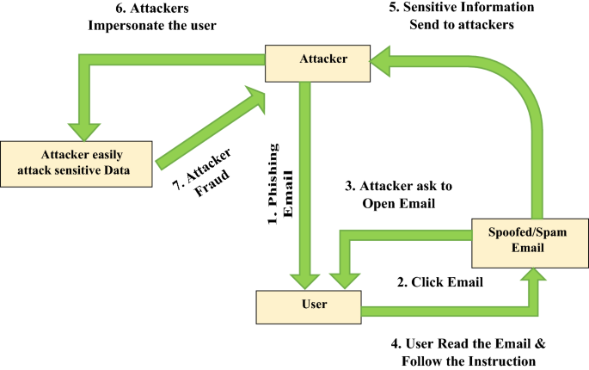
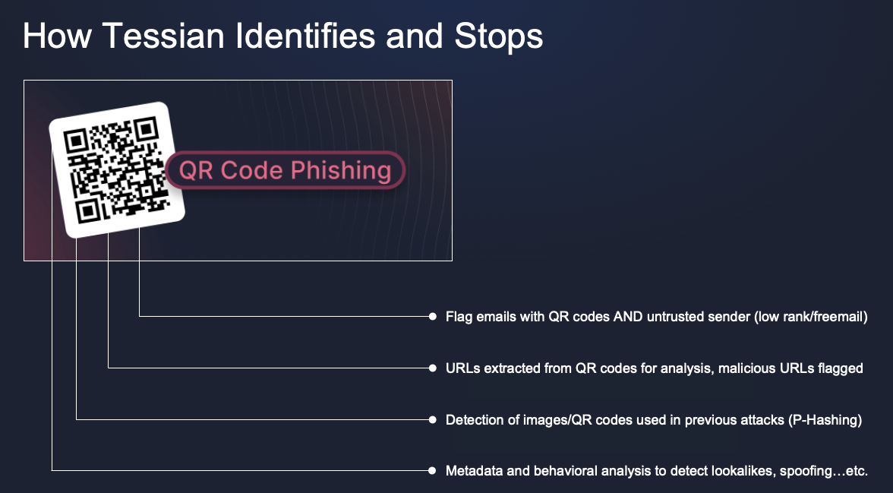
Data Collection
1
Scraping Sources
2
Data Preprocessing
3
Metadata Identification
Utilize web scraping techniques to gather data from various sources, including phishing websites and email repositories.
Clean and prepare the collected data for further analysis and feature extraction processes.
Identify relevant metadata from emails and web pages to enrich the dataset for analysis.

Slide 9
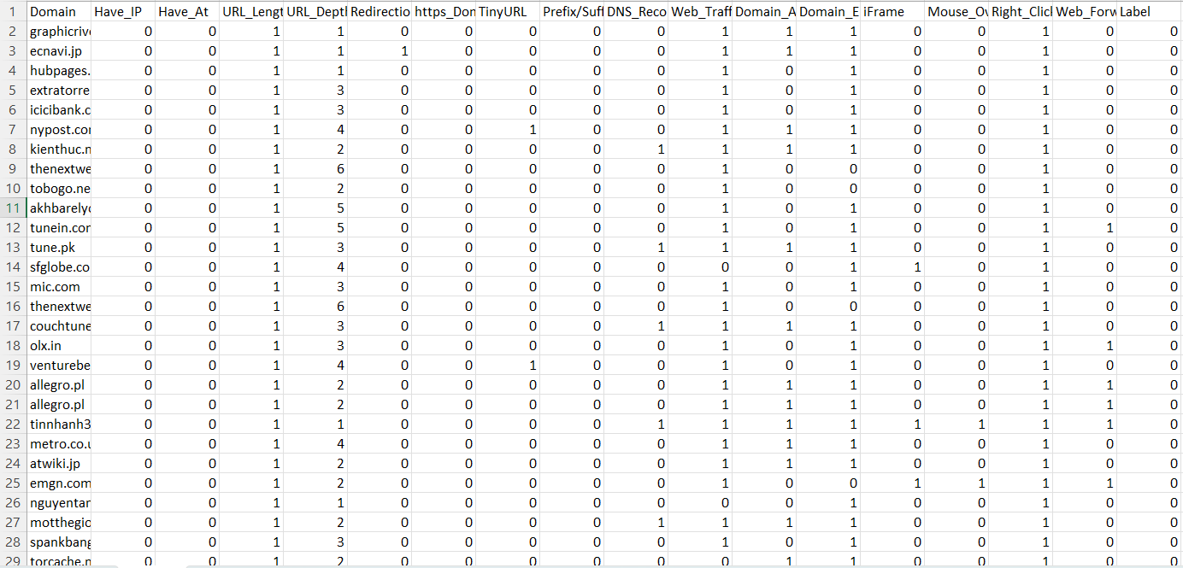
COLLECTION OF DATA

Slide 10
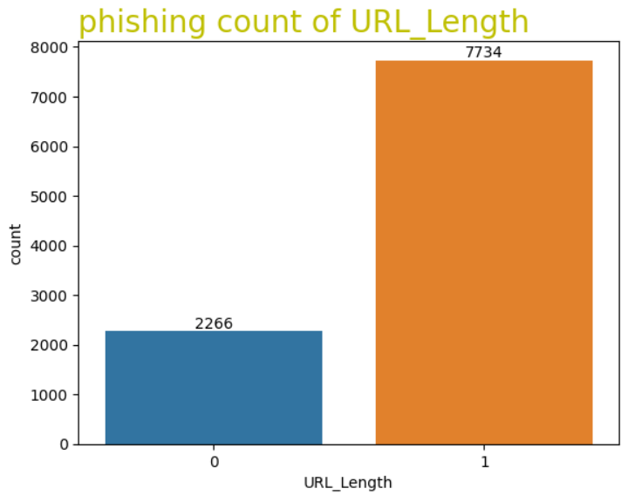
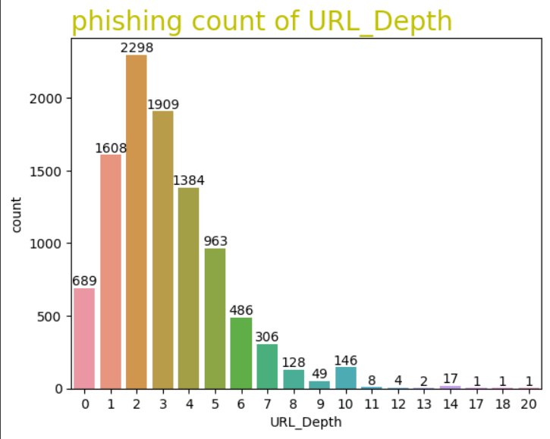
HISTOGRAMS:

Slide 11
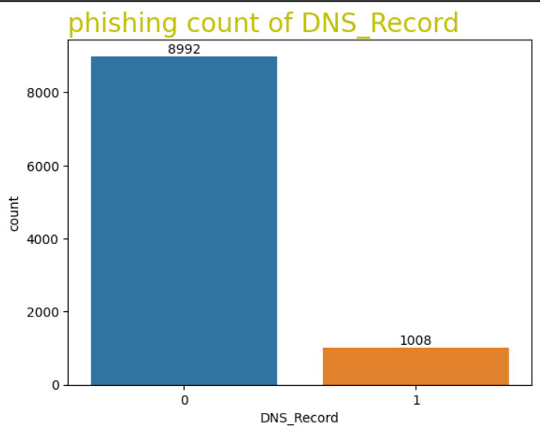
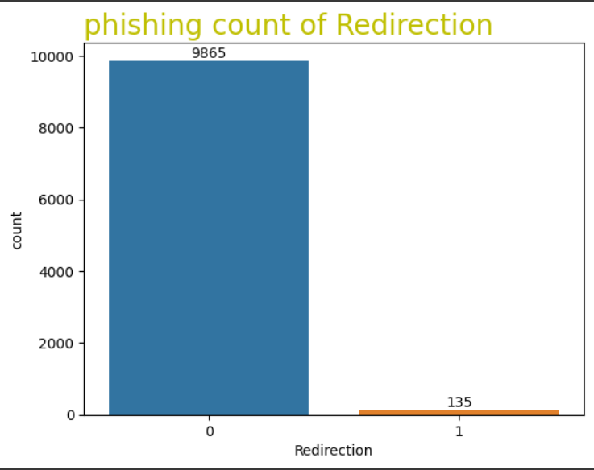
HISTOGRAMS:

Slide 12


Feature Extraction
Text Analysis
Image Processing
Analyze the textual content of phishing emails and websites to identify suspicious patterns and keywords.
Utilize image processing techniques to identify phishing images and logos associated with fraudulent activities.
Example of Image Processing in Phishing Detection
Example of Text Analysis in Phishing Detection

Slide 13
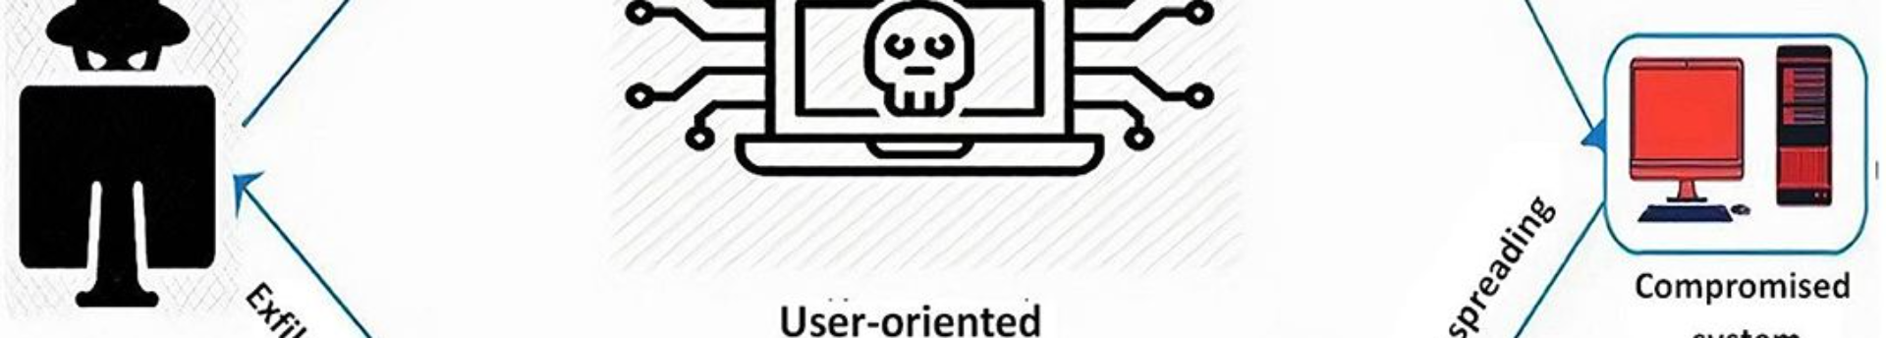



Model Development
Data Segmentation
Algorithm Implementation
Performance Evaluation
Divide the dataset into training, validation, and testing sets for model development and evaluation.
Evaluate the model's performance using various metrics to ensure accurate detection and minimal false positives.
Implement and train machine learning algorithms to classify and detect phishing patterns effectively.

Slide 14
Model Development
Using ‘decision tree classifier’
Decision-Making Nodes:
Leaf nodes and predictions:
Performance Evaluation:
Tree-like structure with decision nodes based on features.
Data splits at each node based on feature values.
Recursive process creates a branching structure.
Terminal nodes (leaves) provide final predictions.
Each leaf is associated with a class or numerical value.
Data traverses the tree, reaching a leaf for the prediction.
Criteria like Gini impurity or information gain guide splits.
Features and values are chosen to maximize subset homogeneity.
Optimal splits aim for accurate predictions in the tree.

Slide 15
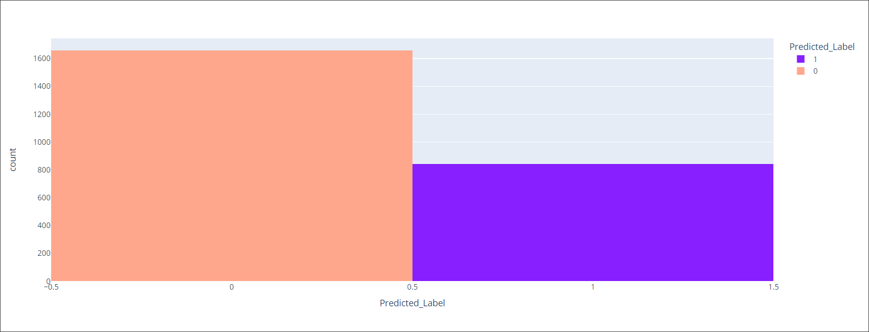
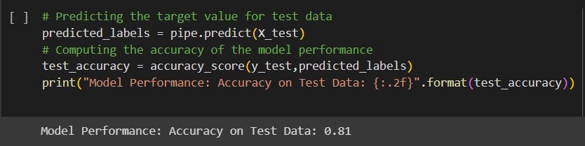
Results and Evaluation
1
2
Phishing Comparison
Accuracy Assessment
Assess the accuracy and effectiveness of the phishing attack detection model using real-world and simulated scenarios.
Compare the phishing URL and non-phishing URLs.

Slide 16
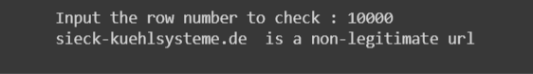

Prediction Example
1
Sample Input
2
Model Output
Details about a hypothetical input for a phishing attack prediction.
Exhibit of the model's output based on the provided input data.

Slide 17


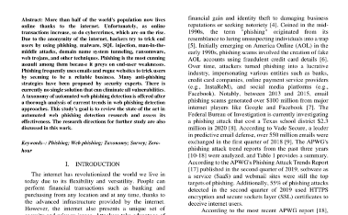


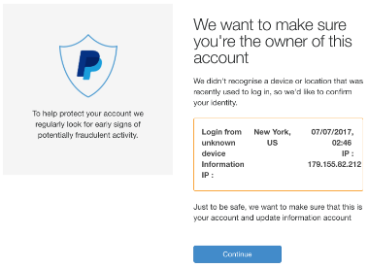
Conclusion and Future Work
Continued Innovation
Industry Collaboration
Future Research
Explore advanced technologies and methodologies for continued innovation in phishing attack detection and prevention.
Collaborate with cybersecurity experts and organizations to enhance phishing detection capabilities and advocate for user awareness.
Engage in research on emerging trends and threats to adapt and evolve phishing attack detection technologies for the future.

